Slide 1
*TITLE SLIDE*
.TITLE: " Simple Calculator using Tkinter in Python"
.SUBTITLE:" a Basic GUI Calculator with Additional Features"
.NAME : ANKUR KUMAR
.DATE : 01-09-2024

Slide 2
INTRODUCTION
. What is a GUI Calculator?
. A Calculator with a Graphical user interface (GUI) that allows users to perform calculations by interacting with buttons and display screens.
. It is a common beginner project to practice GUI development.

Slide 3
PURPOSE OF THE PROJECT
. To learn the basics of GUI programming.
. To implement mathematical operations in a user – friendly application.
. To understand event – driven programming.

Slide 4
*TOOLS AND LIBRARIES *
. Python
. Tkinter: For GUI Development
.Math Library: For advanced mathematical functions (sin, cos, tan)
. IDE: VS Code, PyCharm, or any preferred IDE

Slide 5
*CODE BREAKDOWN- GUI SETUP*
. Setting up the Tkinter Window
root = Tk( )
root. title("Ankur's Calculator")
root.geometry("365 x 410")
Briefly explain the GUI setup, including the window size and title.

Slide 6
*CODE BREAKDOWN-BASIC FUNCTIONS*
Button Clicks
def Btnclick(number):
Explain how he buttons work to input values.
Clear Function
def buttonClear( ):
Explain how to reset the input field.

Slide 7
*CODE BREAKDOWN – ADVANCED FUNCTIONS*
Square and Cube
def BtnSquare ( ), def BtnCube ( )
Explain the implementation of square and cube operations
Trigonometric Functions
def BtnSin ( ), def BtnCos ( ), def BtnTan ( )
Explain how trigonometric calculations are handled.

Slide 8
*DESIGN OVERVIEW*
User Interface Layout:
Simple, intuitive layout with buttons for digits (0-9), operations (+,-,*,/), and functions keys (C, =).
Display screen to show input and results.
Color Scheme:
[Discuss the colors used for buttons, background, etc.]
Font Style:
[Mention the font type and size used for the display and buttons.]

Slide 9
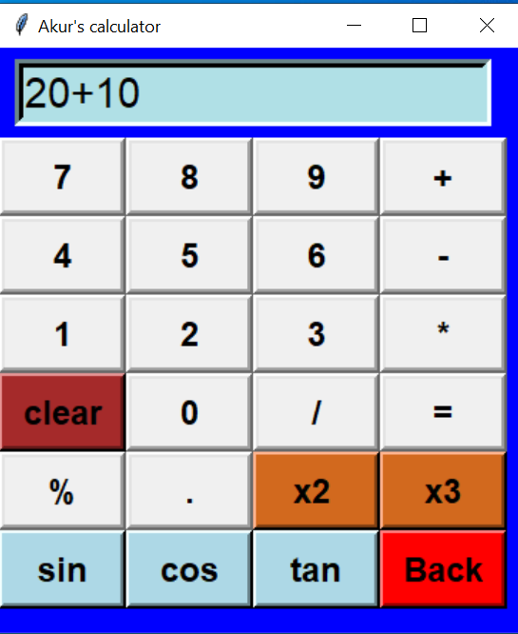
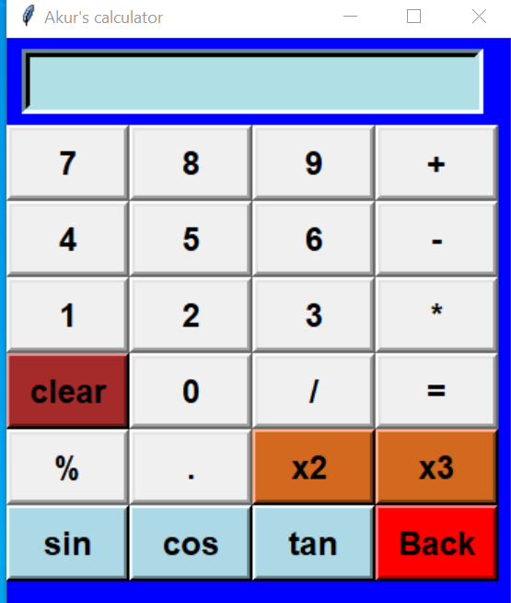
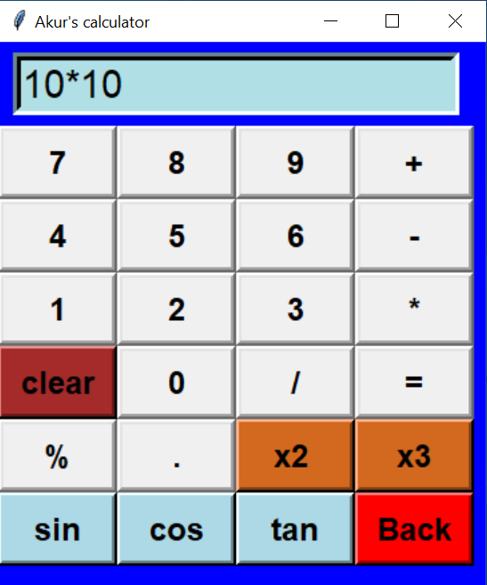
*DEMO*

Slide 10
*CONCLUSION*
Summary:
What I Learned:
Future Improvements:
" Looking forward, I plan to enhance this calculator by adding more advanced features such as scientific functions, memory recall, and a history log of previous calculations. Additionally, I aim to improve the user experience by refining the interface and making it more responsive."
" In this project, I developed a graphical user interface (GUI) calculator that can perform basic arithmetic operations such as addition, subtraction, multiplication, and division. Through this process, I learned how to design and implement a user-friendly interface and handle event-driven programming, which are crucial skills for developing interactive applications."
" I gained valuable experience in GUI development, specifically in [mention the GUI framework used, e.g, Tkinter]. I also improved my understanding of handling user inputs, managing the application state, and ensuring that the program runs smoothly and efficiently."

